Slide 1
Sequential Circuit II
Latch & Flip-flop

Slide 2
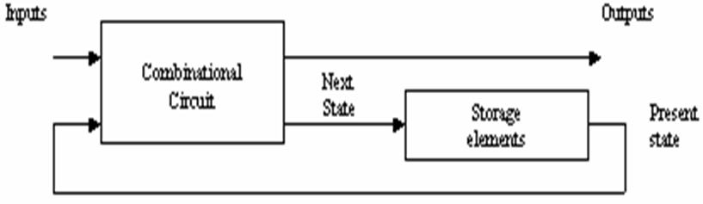
Sequential Logic
Block Diagram of Sequential Logic

Slide 3
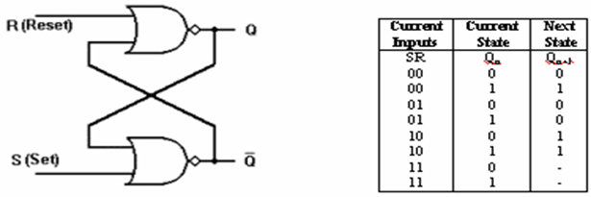
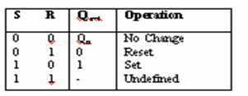
SR NOR Latch
Logical Diagram
Functional Table
Simplified Functional Table

Slide 4
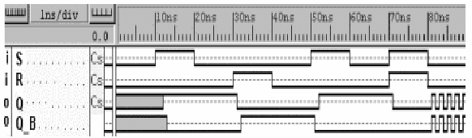
SR NOR Latch
Logical simulation for SR Latch

Slide 5
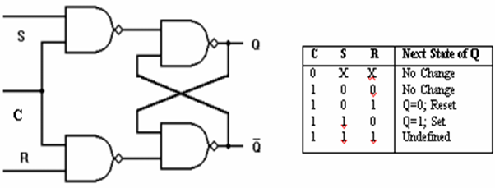
SR NAND Latch with Control Input
Logical Diagram
Functional Table

Slide 6
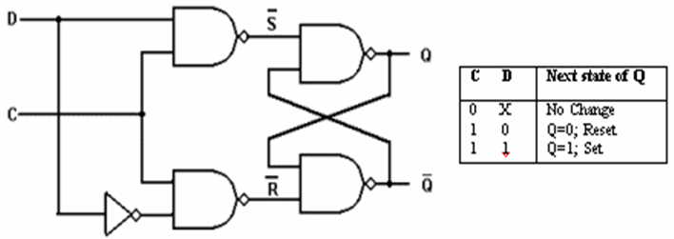
D Type Latch
Logical Diagram
Functional Table

Slide 7
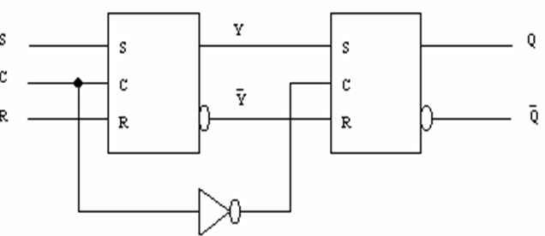
Master Slave Flip-flop

Slide 8
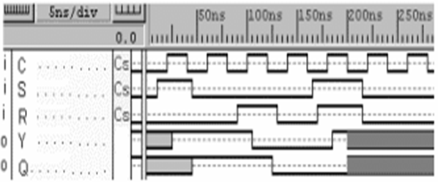
Master Slave Flip-flop

Slide 9
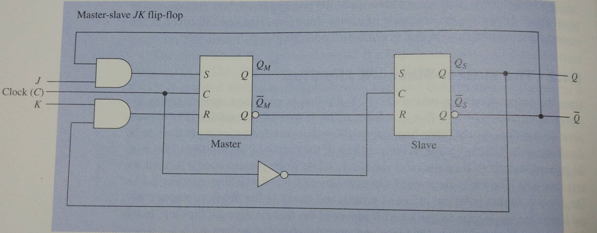
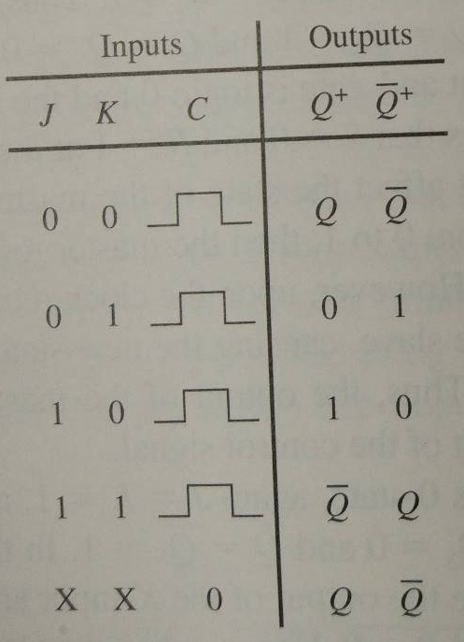
Master Slave JK Flip-flop

Slide 10
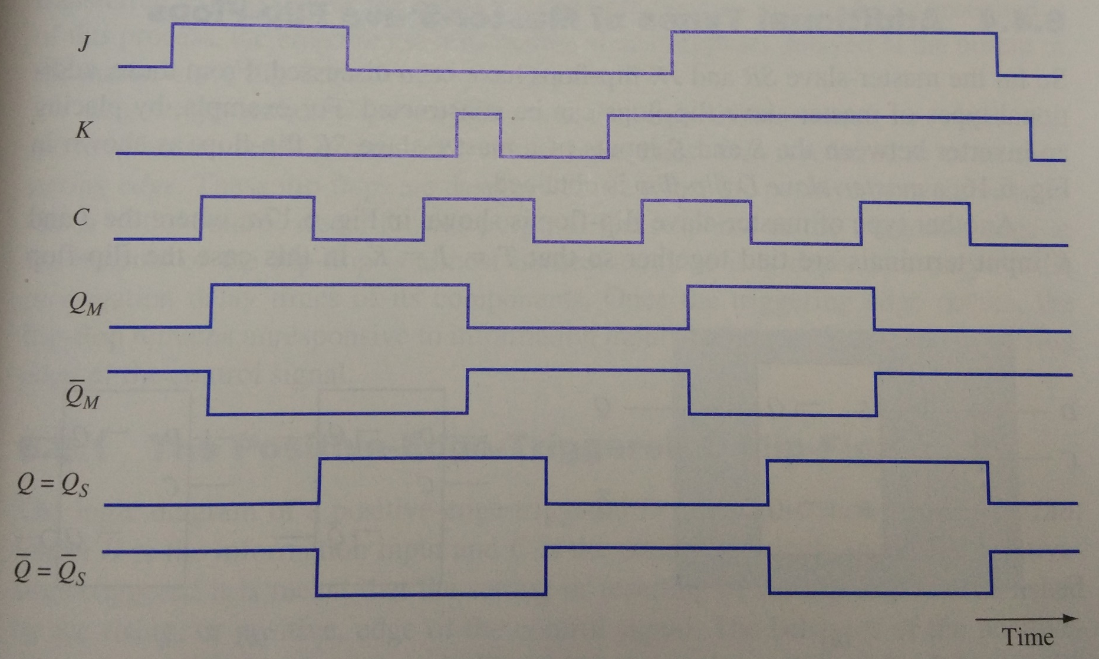
Master Slave JK Flip-flop

Slide 11
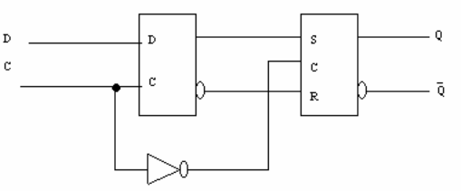
D Type Positive Edge Triggered Flip-flop

Slide 12
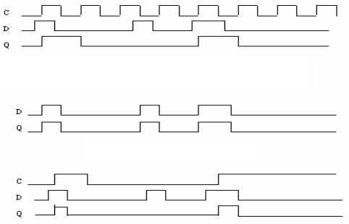
D Type (Flip-flop & Latch)
Positive edge triggered D Type flip-flop simulation
Comparison
D Latch simulation
D Latch with control input simulation

Slide 13
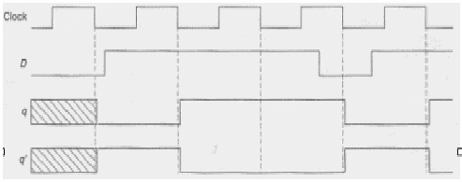
D Type (Flip-flop & Latch)
Negative edge triggered D Type flip-flop simulation

Slide 14
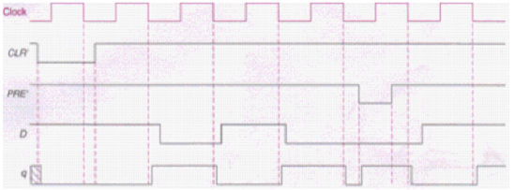
D Type (Flip-flop & Latch)
Negative edge triggered D Type flip-flop with Clear and Preset input simulation

Slide 15
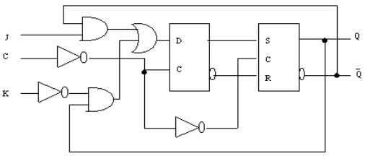
Positive Edge Triggered JK Flip-flop

Slide 16
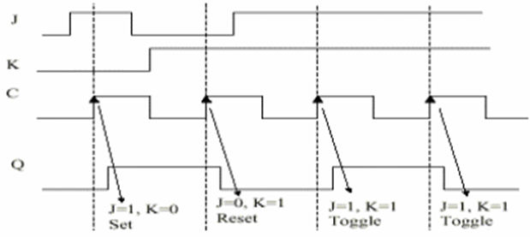
Positive Edge Triggered JK Flip-flop

Slide 17
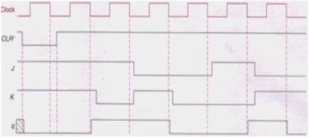
JK Flip-flop
Negative edge JK flip-flop with input Clear simulation

Slide 18
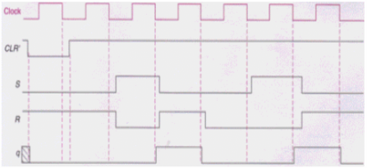
SR Type
Negative edge SR flip-flop with input Clear simulation

Slide 19
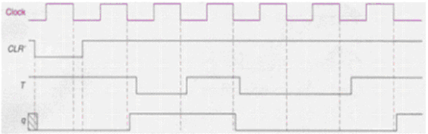

T Type
Negative edge T flip-flop with input Clear simulation

Slide 20

Standard Graphical Symbol
Circle on block shows complement
positive pulse
negative pulse
positive edge
negative edge
Arrow like symbol shows a dynamic input where flip-flop responded towards edge transition for clock pulse input

Slide 21
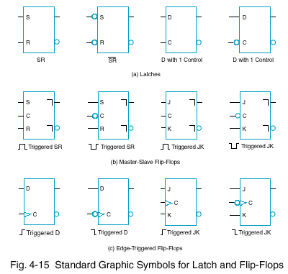
Standard Graphical Symbol

